Slide 1
TH Capture/TH Escape Screening -- Automation
GOOD
BAD
GOOD
BAD

Slide 2
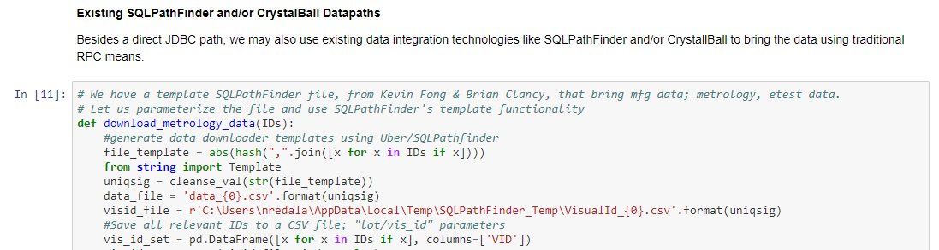
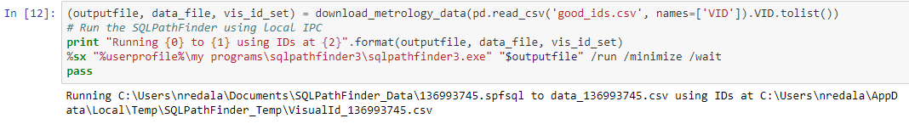
Data Integration

Slide 3
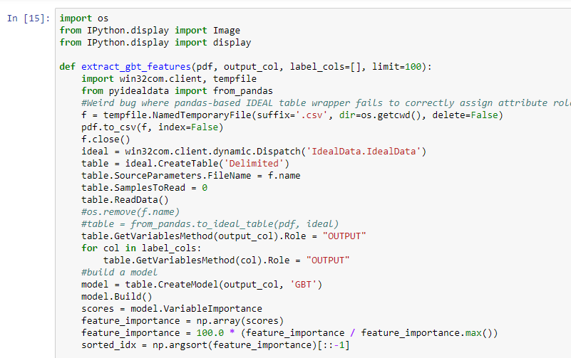
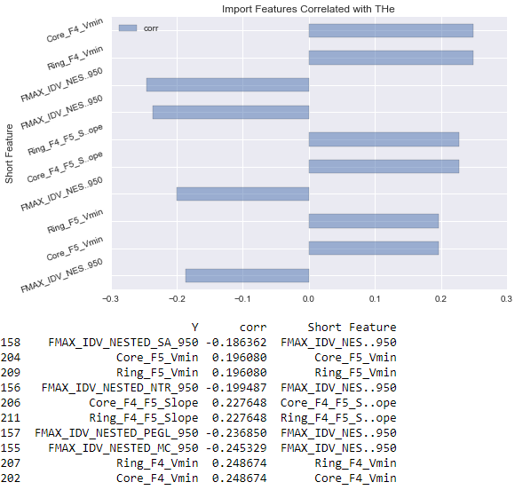
Feature Engineering

Slide 4
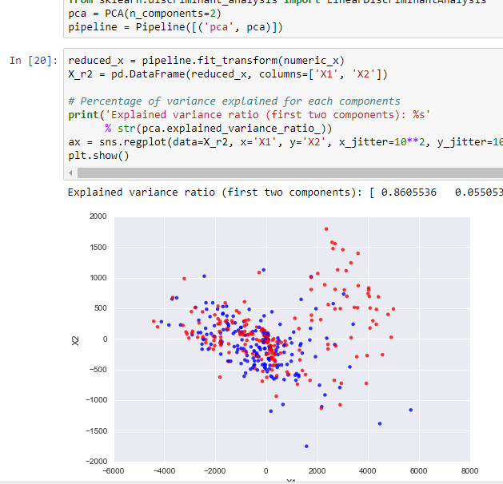
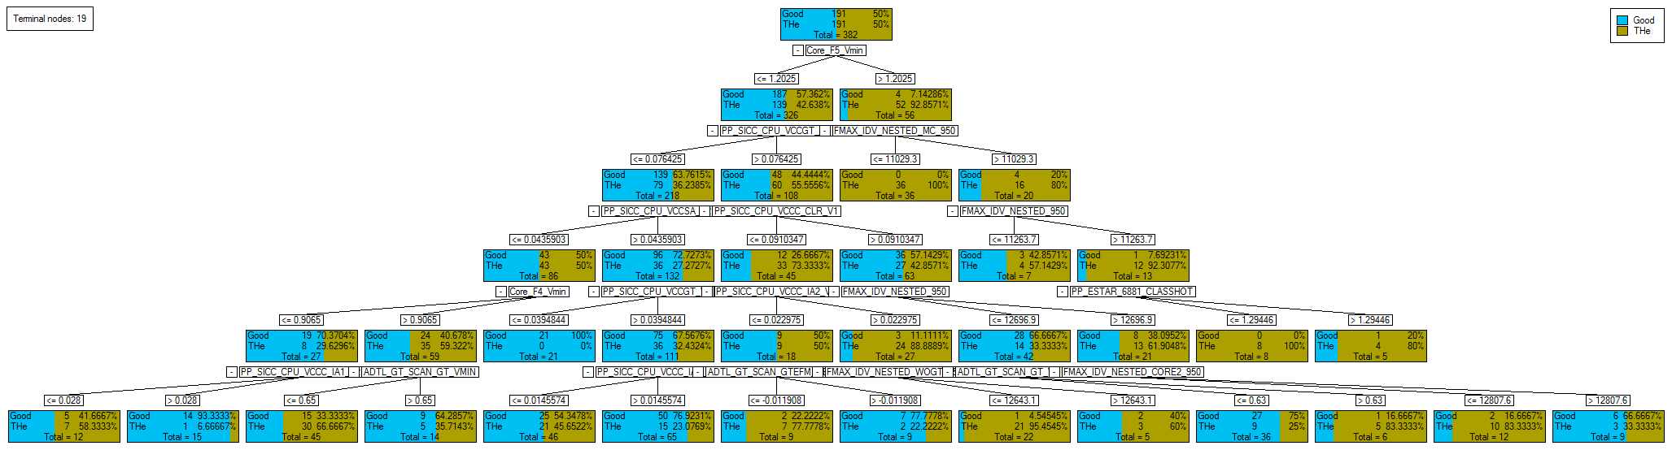
Dimensional Scaling (Critical Variance)

Slide 5
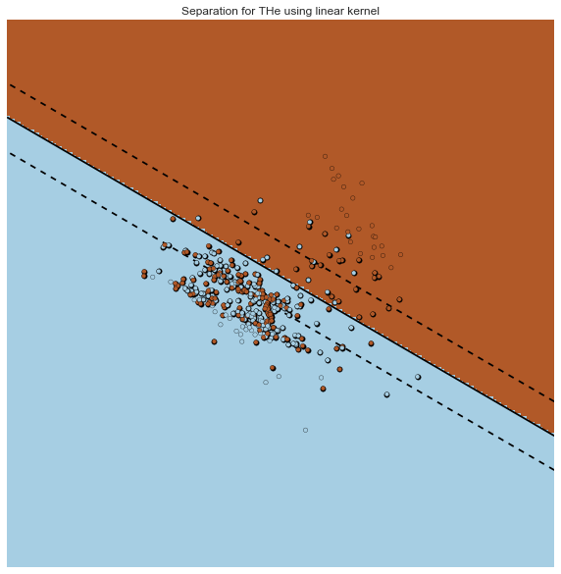
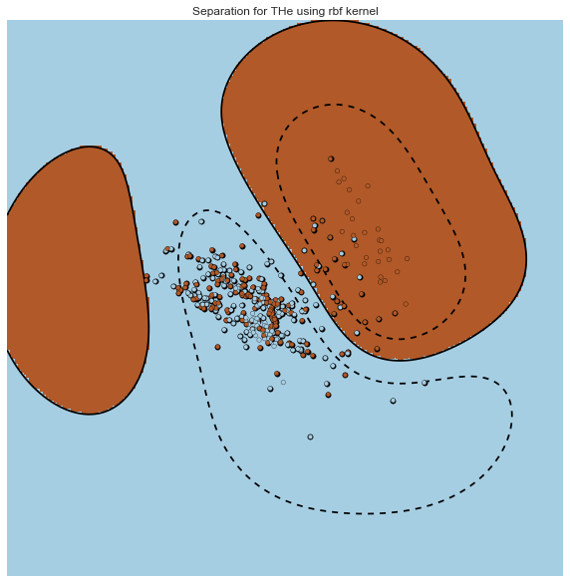
Planar Separation (70/30)

Slide 6
BACKUP: Factory Improvement Tracking (FIT) for Auto (F4A)
Intel Corporation
Patricia, Rafa, Vivienne, Seshu (speaker)

Slide 7
FIT4Auto Scope and Vision
Automotive
Tracks
TS16949
(JBrazil)
FIT4Auto
DB (HW)
(C.Davis)
Test Hole Resolution
(JKronik)
FA/FI
(Kdarschewski)
Automotive Mindset
(ZKraus)
Product Design Improvement (JKronik)
Automotive
15year Data Retention
(Mayu)
FIT4Auto
DB (SW)
(R.Pieper)
FIT4Auto Database (HW and SW)
Problem Statement
Intel does not have a continuous improvement system, that will support the zero defect approach and be customer visible, as required by automotive customers
Vision
Design a new system that can assess the customer failures and combine factory test data, failure analysis understanding, and product improvements driven to demonstrate a continuous improvement system to our automotive customers and deliver the required communication in the correct format
Scope
Provide Root Cause & Corrective Action data system for all Customer Automotive (TSD) returns and demonstrate a continuous improvement with a 0 DPM approach.
Combine Factory data (15yrs), test & FA data to demonstrate & communicate our Continuous Improvement efforts to our customers in the way they need it
Deliver the FIT-4-Automotive data requirements to Data Retention Team for 15 year retention

Slide 8
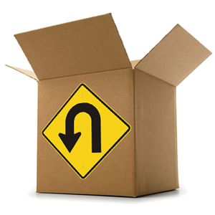
Agenda
Define data lake
Business objectives
Customer Imperatives
Demo(s)

Slide 9
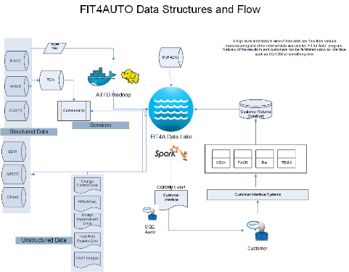
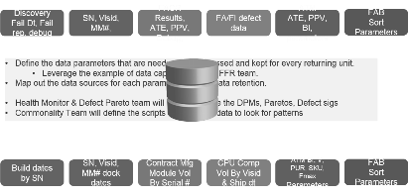
Unit Data – Volume Data → Develop Data Lake
Customer
Intel Debug
FA/FI
Factory
Shipments
Communications
Change Mgmt

Slide 10











Why Data Lake?
Conform ahead
A relational store to scalably store, join correlate, and summarize huge datasets
$$$$$
Operational
OLTP
Analytical
OLAP
Actionable
MDX
An online storage repository that holds vast amount of raw data in native format
$$$
Cheap raw native storage in offline filers
Databases
Data Warehouse
Datamart
Compulsive hoarding
$$
MAO
TCA
FACR
CAP
Heterogeneous
Scalable
Mutable
$$$
Relational
Columnar
Connected
Hierarchic
Monotonic
entities
attributes
relations
tacit

Slide 11

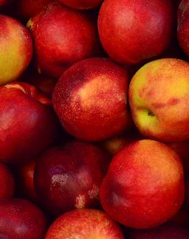
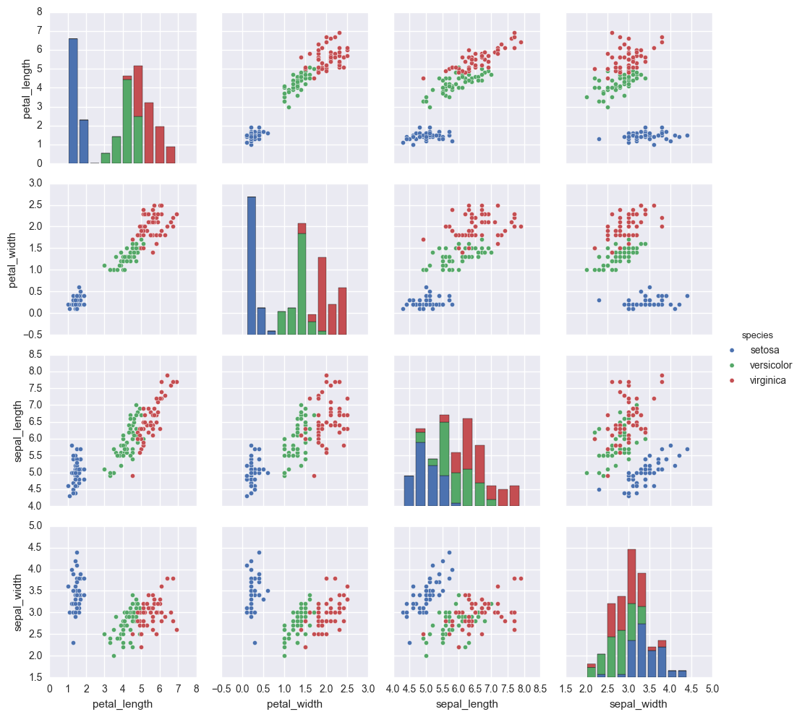
Bad apples v Good apples

Slide 12


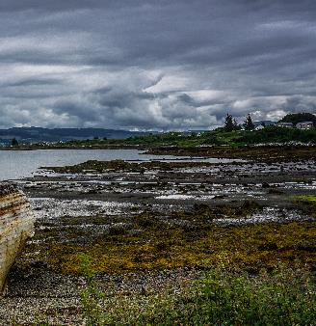
Data Lake
A single logical storage and nearline analytical universe for hybrid data. It is a warehouse

Slide 13
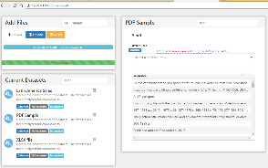
Customer Imperatives
1. Schema Friendly
Relational
Columnar
Connected
Hierarchic
Monotonic
entities
attributes
relations
tacit

Slide 14
Customer Imperatives
2. Cost Effective
MPP Warehouse
Data Lake
Filers
$20000/TB
$1000/TB
$100/TB

Slide 15




Customer Imperatives
3. In-situ Analytics
Business Intelligence
Descriptive Stats
Diagnostic Analytics
Predictive Analytics

Slide 16
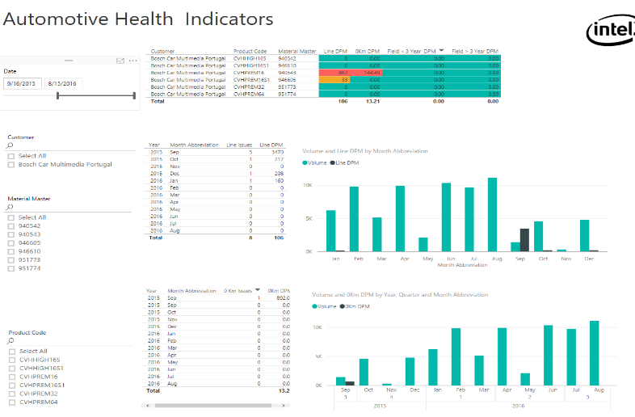

Slide 17
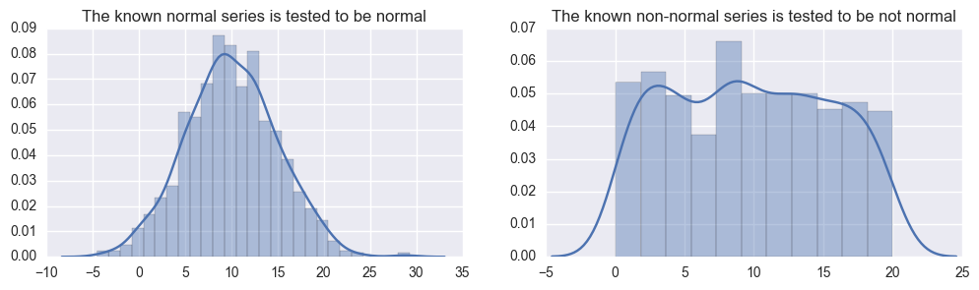
Descriptive Statistics
Time | Temperature
0900 | 23.87657
1000 | 25.78983
1100 | 24.56723
1200 | 24.56217
1300 | 26.65325
1400 | 25.10976
1500 | 24.26743
… | …
Time | Temperature
0900 | 23.87657
1000 | 23.87657
1100 | 23.87657
1200 | 23.87657
1300 | 23.87657
1400 | 75.67832
1500 | 23.87657
… | …

Slide 18

Predictive Analytics
Good
Bad

